Slide 1
UNIT-1
High Performance Computing most generally refers to the practice of aggregating computing power in a way that delivers much higher performance than one could get out of a typical desktop computer or workstation in order to solve large problems in science, engineering, or business.
High performance computing (HPC) is the ability to process data and perform complex calculations at high speeds. To put it into perspective, a laptop or desktop with a 3 GHz processor can perform around 3 billion calculations per second.
What Is High-Performance Computing?
High-Performance Computing is the practice of combining computing power to deliver much more performance than a typical computer. This is achieved using parallel data processing systems where several servers work together to complete a task.
HPC increases the computing performance, giving complex calculations and advanced applications a smooth run. For instance, a 3GHz processor in a typical laptop can perform up to 3 billion calculations in a second. But, an HPC can perform quadrillions of calculations in a second. That’s how fast an HPC can operate, a great example being the supercomputer.
The high-performance computing system was developed to meet the rising demand for faster, reliable, and scalable compute speeds. Modern HPCs bring together algorithms, computer architecture, system software, specialty programs and apps, advanced sensors, etc. These systems find applications in high-performance environments where speed, accuracy, and reliability are given priority.
Characteristics of High-Performance Computing
The three main components of an HPC system are compute, storage and network. The compute components comprise parts such as the motherboard, RAM, CPU, hard drive, etc., needed to complete specific tasks such as running computations and critical software. Networking components ensure the system and the users are well connected, allowing access to critical resources like remote computers and the Internet. Storage components hold the recorded data and ensure they are easily accessible whenever needed.
In an HPC, multiple computer servers are networked to form a cluster, which serves as an
efficient HPC architecture system. The servers in the cluster are concurrently run with algorithms and software programs to complete different tasks. And to store or access required information, the cluster is networked to data storage systems.

Slide 2
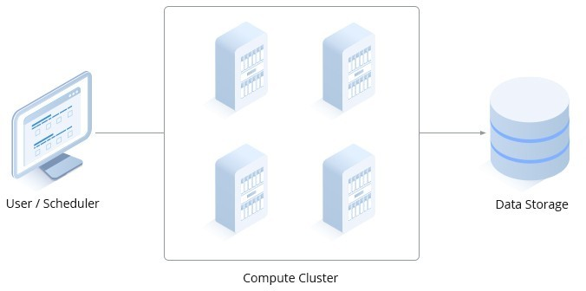
Each component of the high-performance computing infrastructure must keep pace with each other to ensure maximum performance. All networking systems should also have the capacity to support the high-speed data transmission between the computing servers and data storage.
Other distinctive features of the high-performance computing system are:
Powerful search – HPCs have powerful search capabilities that allow users to easily navigate between files, applications, and huge databases. This makes regular interaction with the computer quite convenient.
Advanced directory browsing – the HPC has advanced mechanisms that allow for traversing
directory standards. This gives users the option to cache directory lists from distributed hosts, enabling fast re-display of previously visited directories.
Authentication management – to make system authentication and access a breeze, HPCs allow trusted connections to be cached and re-used. This means authentication information can be stored during a session and re-used the next time you want to use the system.
Drag and drop file transfer – this allows for faster transfer of files and enhances the user experience, especially when dealing with huge data sets.
Directory synchronization – HPC allows for synchronizing remote or local directories, where
old files (in the destination folder) can be replaced by newer ones in the source file/folder.
Why is High-performance Computing Important?
HPC has played a significant role in the research and innovation worlds for decades. Engineers, designers, scientists, and other professionals have leveraged the power of HPC to make significant breakthroughs. Below are the primary benefits of HPCs.
High Speed
HPCs are designed for fast-speed processing. This translates to HPC systems performing massive calculations in seconds that would have taken weeks or months using regular processors.

Slide 3
Reduced Cost
Since HPC systems have a high processing speed, applications run faster, and therefore answers to complex calculations are yielded quickly. Fast calculations translate to less money and time spent on tasks. In addition, startups and small businesses can afford to run HPC workloads using cloud-based HPC since they only have to pay for what they use and can scale up when and where needed.
Reduced Physical Testing
Most modern-day applications require physical testing before being used in the market. HPC systems can create simulations, thus eliminating the need for physical tests, which can be costly and prone to errors.
What is High Performance Computing?
High Performance Computing, or HPC could be defined as the aggregation of computing power from multiple computers/servers and their use in large computing problems.
These problems can be too heavy for typical work teams that would take too long and would therefore be unfeasible.
This approach also makes it possible to increase the accuracy of results since the computing power available is higher.
How does High Performance Computing work?
The architecture and operation of an HPC cluster can be quite complex, but to simplify it, it can be divided into 4 areas:
The Skeleton
These are the base components:
Login node: component responsible for handling the login of the users in the cluster, as well as handling remote desktops.
Master node: component responsible for orchestrating the resources of the cluster, also called scheduler.
Computing
It is the component responsible for performing the users’ jobs.
Storage
It is the component responsible for data persistence.

Slide 4
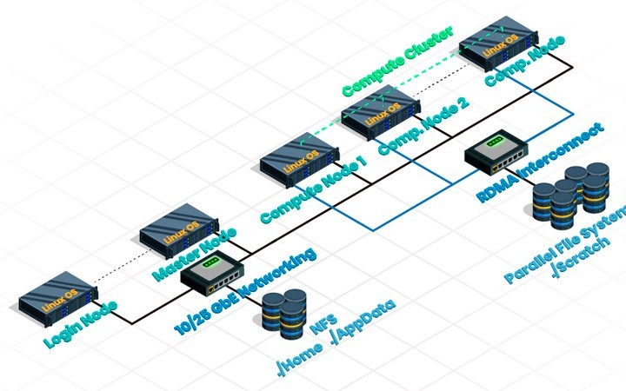
NFS: used to store results and user data.
Parallel File System: used by compute nodes during calculations.
Networking
Responsible for communication between components.
The whole system: connected by Gigabit Ethernet.
Compute nodes and Parallel File System: connected by high-speed RDMA.
The use of the system by the user would normally be as follows:
Uploading of data related to the study/calculation to be carried out.
Login to the system and prepare the work to be done.
Sending the work to the scheduler: requesting the necessary resources such as the number of cores.
Analysis or downloading of the results.
Use cases and state of art in High Performance Computing
Currently the use of HPC systems is growing as in recent years the use cases and industries that can benefit from their use are also increasing.

Slide 5
This is due, in part, to system capacity and GPU utilization. The success stories are diverse and in many areas, such as.
Computational Fluid Dynamics (CFD)
Environmental study of buildings.
Safety and health: Investigation of the effects of fire and smoke.
Medicine: Studies of blood flow through capillaries, arteries, veins.
Artificial Intelligence with High Performance Computing
Precision medicine: cancer diagnosis
Cyber threat Analysis.
Weather and Climate Modeling.
Big Data
Weather Forecasting.
Fraud detection.
Rendering
Render farms.
Computational complexity is a continuum, in that some algorithms require linear time (that is, the time required increases directly with the number of items or nodes in the list, graph, or network being processed), whereas others require quadratic or even exponential time to complete. (that is, the time required increases directly with the number of items or nodes in the list, graph, or network being processed), whereas others require quadratic or even exponential time to complete (that is, the time required increases with the number of items squared or with the exponential of that number). At the far end of this continuum lie intractable problems—those whose solutions cannot be efficiently implemented. For those problems, computer scientists seek to find heuristic algorithms that can almost solve the problem and run in a reasonable amount of time.
computational complexity, a measure of the amount of computing resources (time and space) that a particular algorithm consumes when it runs.
Performance: metrics and measurements
https://www.dcc.fc.up.pt/~ricroc/aulas/1516/cp/apontamentos/slides_metrics.pdf

Slide 6
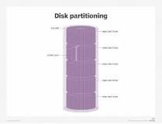
Two principal metrics are used to measure an HPC's performance: throughput and latency. Throughput measures the amount of data processed by a system in a given unit of time and is typically expressed as I/O operations per second (IOPS)
Computer performance metrics (things to measure) include availability, response time, channel capacity, latency, completion time, service time, bandwidth, throughput, relative efficiency, scalability, performance per watt, compression ratio, instruction path length and speed up. CPU benchmarks are available.
There are five specific types of measures that have been identified, defined and will be applied throughout Iowa state government: input, output, efficiency, quality and outcome.
Granularity and Partitioning
In parallel computing, granularity (or grain size) of a task is a measure of the amount of work (or computation) which is performed by that task. Another definition of granularity takes into account the communication overhead between multiple processors or processing elements.
What does granularity mean in computer?
In computer science, granularity refers to a ratio of computation to communication – and also, in the classical sense, to the breaking down of larger holistic tasks into smaller, more finely delegated tasks.
The ability to increase a system's capacity and performance through incremental processor expansion.
What is partition in HPC?
A partition refers to a group of nodes which are characterised by their hardware. The partitions available can be listed via the command sinfo . The partition can be set by using the following in the submit script: #SBATCH --partition=gpu.
What is Partitioning in computing?

Slide 7
A partition is a logical division of a hard disk that is treated as a separate unit by operating systems (OSes) and file systems. The OSes and file systems can manage information on each partition as if it were a distinct hard drive.
What is the advantage of Partitioning?
Partitioning improves the performance of the delete old version shell script since all old version data is in a separate partition. By having all current version data in a separate partition, more current version data is available in database memory that results in efficient use of database buffer pools.
What are the 3 levels of partitioning?
Chapter 3 Partitioning Types
RANGE partitioning. This type of partitioning assigns rows to partitions based on column values falling within a given range. ...
LIST partitioning. ...
HASH partitioning. ...
KEY partitioning.
What are the two types of partitioning?
The two types of partitions are: Primary partition. Extended partition.
Does partitioning improve performance?
Partitioning can also improve the performance of multi-table joins by using a technique known as partition-wise joins.
Locality: temporal/spatial/stream/kernel
What is temporal locality and spatial locality?
Temporal locality refers to the reuse of specific data and/or resources within a relatively small time duration. Spatial locality (also termed data locality) refers to the use of data elements within relatively close storage locations.
There are three kinds of locality of reference: temporal, spatial, and network. What is an example of spatial locality?

Slide 8
Spatial locality: Programs tend to access data that is nearby other, previously accessed data. "Nearby" here refers to the data's memory address. For example, if a program accesses data at addresses N and N+4, it's likely to access N+8 soon.
What is an example of temporal locality?
Notice that in every single instruction, the filing clerk needs to access the total card. This is an example of temporal locality because it involves accessing the same piece of data frequently over a short period of time.
What are the basics of parallel programming?
Parallel programming, in simple terms, is the process of decomposing a problem into smaller tasks that can be executed at the same time using multiple compute resources
What are the types of parallel programming model?
Two widely known parallel programming models are shared memory and message passing, but there are also different combinations of both.
The term parallel programming may be used interchangeable with parallel processing or in conjunction with parallel computing, which refers to the systems that enable the high efficiency of parallel programming.
In parallel programming, tasks are parallelized so that they can be run at the same time by using multiple computers or multiple cores within a CPU. Parallel programming is critical for large scale projects in which speed and accuracy are needed. It is a complex task, but allows developers, researchers, and users to accomplish research and analysis quicker than with a program that can only process one task at a time.
How Does Parallel Programming Work?
Parallel programming works by assigning tasks to different nodes or cores. In High Performance Computing (HPC) systems, a node is a self-contained unit of a computer system contains memory and processors running an operating system. Processors, such as central processing units (CPUs) and graphics processing units (GPUs), are chips that contain a set of cores. Cores are the units executing commands; there can be multiple cores in a processor and multiple processors in a node.
With parallel programming, a developer writes code with specialized software to make it easy for them to run their program across on multiple nodes or processors. A simple example of

Slide 9
where parallel programming could be used to speed up processing is recoloring an image. A developer writes the code to break up the overall task of to change the individual aspects of an image by segmenting the image into equal parts and then assigns the recoloring of each part to a different parallel task, each running on their own compute resources. Once the parallel tasks have completed, the full image is reassembled.
Parallel processing techniques can be utilized on devices ranging from embedded, mobile, laptops, and workstations to the world’s largest supercomputers. Different computer languages provide various technologies to enable parallelism. For C, C++ and Fortran, OpenMP, open multi-processing, provides a cross-platform API for developing parallel applications that enable running parallel tasks across cores of a CPU. When processes need to communicate between different computers or nodes, a technology such as MPI, message passing interface, is typically used. There are benefits to both models. Multiple cores on a single node share memory. Shared memory is typically faster for exchanging information than message passing between nodes over a network. However, there’s a limit to how many cores a single node can have. As projects get larger, developers may use both types of parallelism together. One of the challenges that developers face though is properly decomposing their algorithm and parallelizing across multiple nodes and multiple cores for maximum performance and debugging their parallel application when it does not work correctly.
What Is Parallel Programming Used For?
Parallel programming’s ability to decompose tasks makes it a suitable solution for complex problems involving large quantities of data, complex calculations or large simulations. Previously unsolvable problems have been decomposed using parallel programming, such as weather simulations, vaccine development, and astrophysics research.
Parallel programming use cases include:
Advanced graphics in the entertainment industry
Applied physics
Climate research
Electrical engineering
Financial and economic modeling
Molecular modeling
National defense and nuclear weaponry
Oil and gas exploration
Quantum mechanics
There are 5 basic way to go parallel;

Slide 10
Compiler assistance
Library calls
Directives
Low level hardware targeting
Message Passing
The first 4 of these are mostly focused on single node parallelism with vectorization, threading and offload accelerator targeting. This is very important since it is now possible to have a single workstation with dozens of CPU cores and hundreds of accelerator cores capable of handling possibly thousands of execution threads. A high end workstation can rival the compute capability of million dollar “Supercomputers” from only a few years ago!
The 5th method, Message Passing, is the traditional method of parallel computing and is still very important. Current MPI implementations can take advantage of multiple many-core CPU’s on a single node with performance that is as good (or sometimes better) than methods that are targeted more at multi-threading. And, for parallel computing across multiple nodes message passing is very well understood and widely used.
What are the four programming models?
Streaming Model, Shared-Memory Multiprocessor Model, Asymmetric-Thread Runtime Model, User-Mode Thread Model.

